Slide 1

Keys in Relational Model

Slide 2
Topic of discussion
What is Key?
Super Key
Candidate Key
Primary Key and
Foreign Key

Slide 3

Key in DBMS
A DBMS key is an attribute or set of an attribute which helps you to identify a row (tuple) in a relation (table).
They allow you to find the relation between two tables.
Keys help you uniquely identify a row in a table by a combination of one or more columns in that table

Slide 4
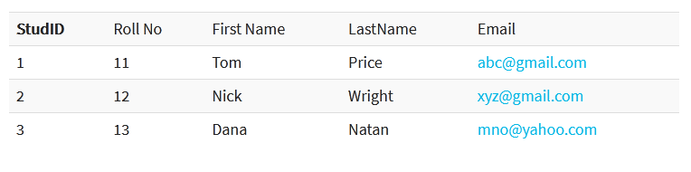
Candidate Key
A candidate key is a set of attributes (or attribute) which uniquely identify the tuples in relation or table.
candidate key set { StudID, Roll No, Email }

Slide 5
Primary Key
There can be more than one candidate key in relation out of which one can be chosen as the primary key.
PRIMARY KEY is a column in a table that uniquely identify every row in that table.
Primary Key { StudID }

Slide 6
Alternate Key
The candidate key other than the primary key is called an alternate key.
Alternate key { Roll No, Email }

Slide 7
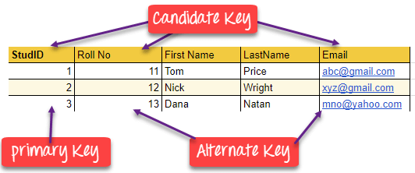

Slide 8
Super Key
The set of attributes which can uniquely identify a tuple is known as Super Key.
Super key set {StudID, First Name},{Roll No, First Name} { StudID, Second Name}, { Email, Second Name}, {StudID, First Name, Second Name}………

Slide 9
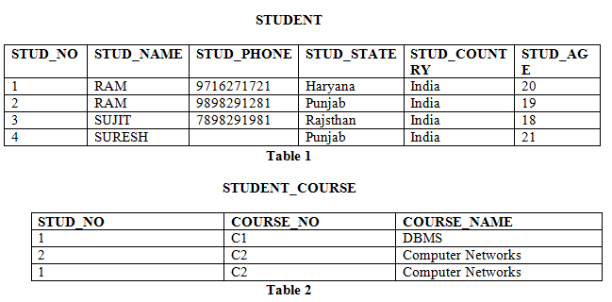
Foreign Key
FOREIGN KEY is a column that creates a relationship between two tables.

Slide 10
Thank you

